Slide 1
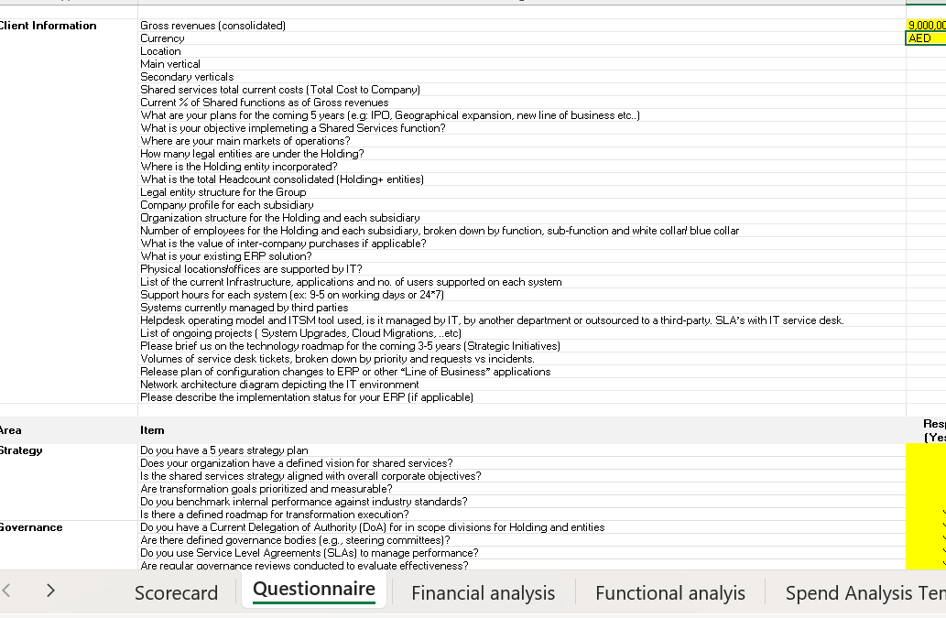
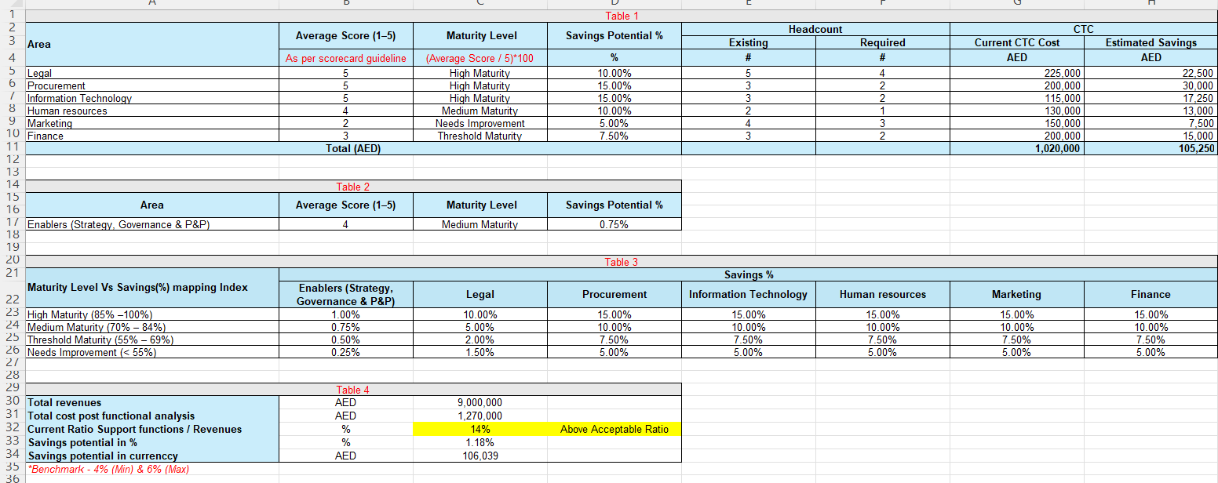
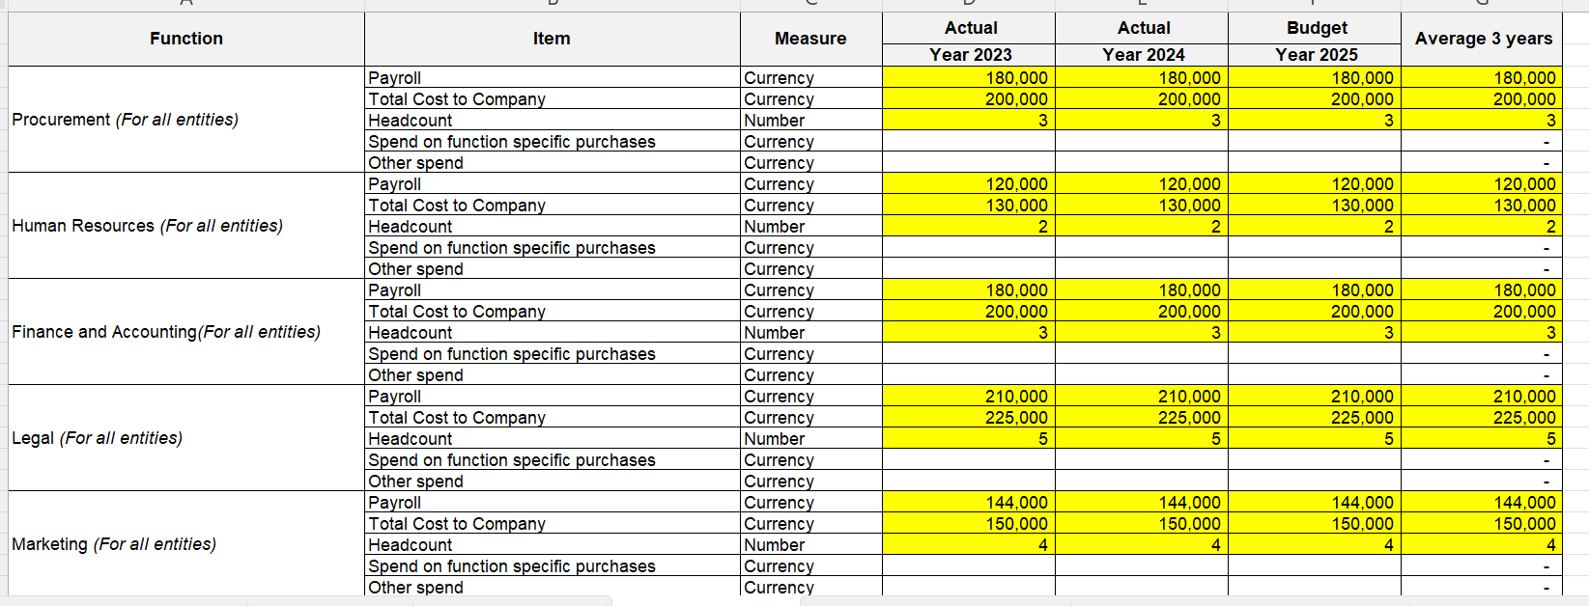
Proprietary Methodology: “Shared Services Assessment Tool” ©
A robust and adaptable proprietary assessment methodology designed to provide a clear understanding of an organization's current state and future potential. Our tool leverages a comprehensive questionnaire and a structured scorecard system to ensure thorough analysis of your Supporting functions.
Our methodology provides a clear, data-driven approach:
Comprehensive Assessment:
Industry benchmarking:
We analyze your specific industry landscape and internal workflows to tailor the assessment to your unique context
Maturity Level Determination: Through a detailed Scorecard, we accurately determine your company's current maturity level across various operational and functional areas
Strategic Opportunity Identification:
Opportunity Cost Analysis: Leveraging our Financial analysis module, the tool calculates potential opportunity costs and quantifies the financial impact of current inefficiencies, providing a clear business case for change
Actionable Roadmap Design:
Based on the assessment findings and identified opportunities, we design a precise and actionable project roadmap. This roadmap outlines the necessary steps to transition from your current maturity level to an optimized future state, aligning with your strategic objective
Clear organizational Baseline: Understand your current operational and strategic maturity • Quantifiable ROI: Pinpoint and measure the financial benefits of transformation
• Tailored Strategic Roadmap: Receive a customized, step-by-step plan for improvement • Accelerated Performance: Drive efficiency, mitigate risks, and achieve sustainable growth • Informed Decision-Making: Equip leadership with the insights needed for strategic planning and resource allocation

